Slide 1
Data Science Industry & Project Execution

Slide 2
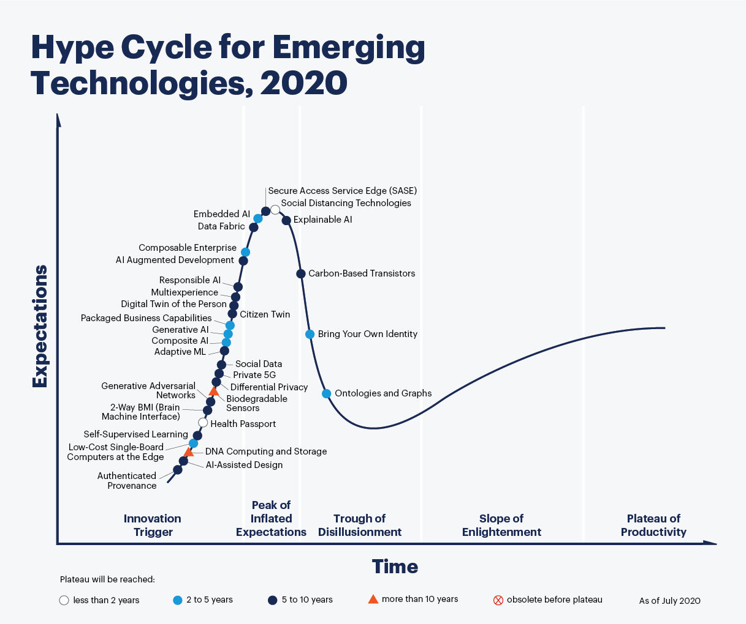
Data Science Industry

Slide 3
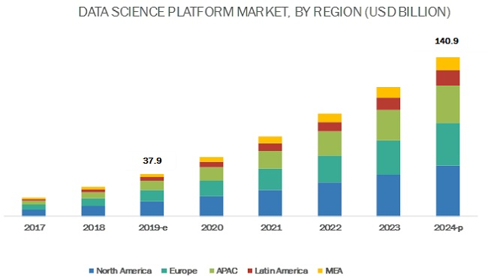
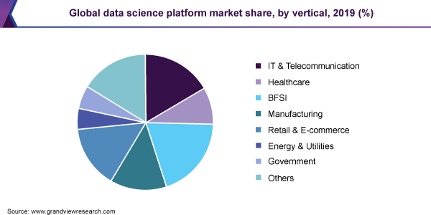
Data Science Industry

Slide 4
Data Science Use Cases
Healthcare
Sales Forecasting
Disease Prediction & Prevention
Supply Chain Management using ML
Telecom
Churn Prediction
Cross-Sell Services
Spam call Identification
Retail
Store Optimization
Revenue Forecasting
Offer Bundling
Insurance
Damage Control Modelling
Premium Forecasting
Fraud Claim Predictions
Financial Services
Stock Markets Prediction
Portfolio Optimization & Risk Management
Deep Personalization
Automobiles
Preventive Maintenance
IoT based Failure Prediction
Cost Control Models

Slide 5
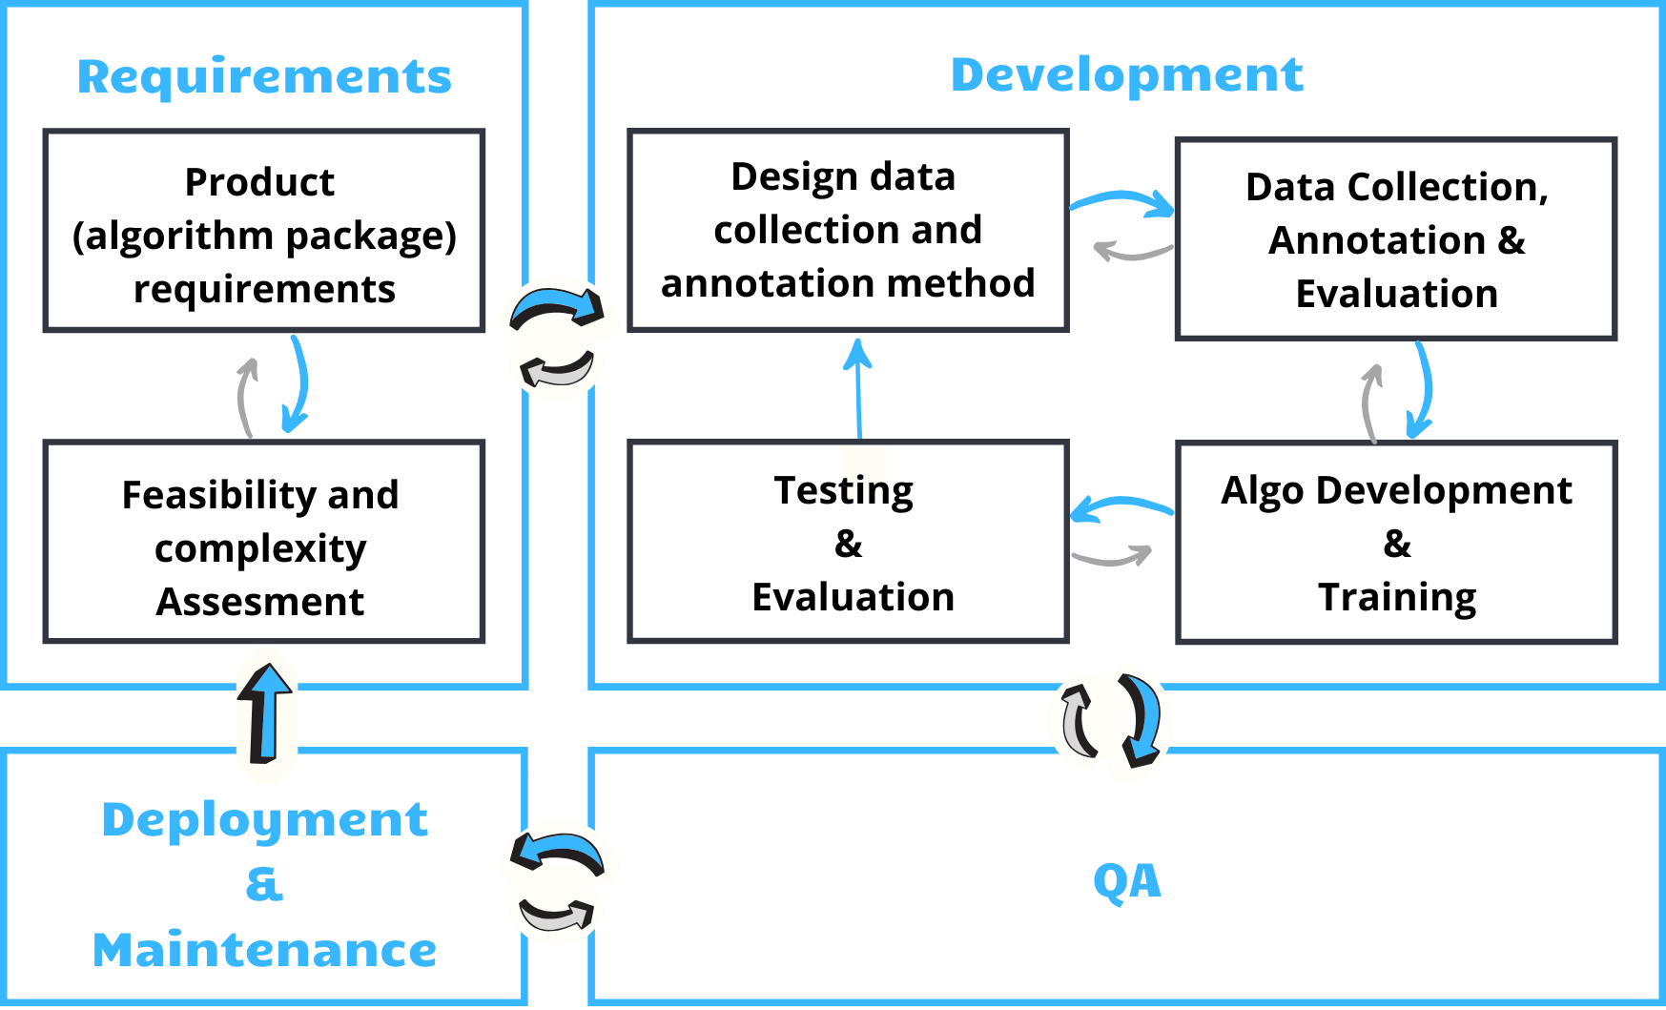
Data Science Project Cycle

Slide 6
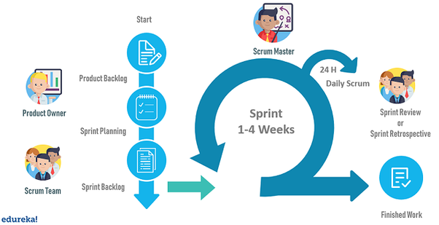
Scrum Methodology

Slide 7
Data Science Project Components
Product Backlog:
The Business Outcome and Data Availability needs form the user stories for a machine learning product.
The stories can be part of EDA, Feature engineering & model building
The Product Backlog features are part of Agile Process where they will be revised over different sprints
Sprint:
A sprint is the key unit of iterative development in the machine learning process.
It is typically 2–4 weeks and encompasses all activities in the above diagram.
In a typical sprint, the data scientist can do the following
Access raw data from a new or existing data source
Perform feature engineering
Train/Re-train the machine learning model
Deploying to an end-point or on independent server

Slide 8
Data Science Project Components
Sprint Review
The sprint review focusses more on the business objectives & the ML process towards it
Deviations will be course-corrected to stand in-line with the Primary & Secondary goals
Product Building activities usually involve ML as a Backend Process ( Model-As-A-Service)
The Products will have encompass different technology stacks ( ReactJS, JS, PHP)
These stacks have to be integrated properly to enhance the Customer Experience
Metrics Revision & Accuracy enhancement are taken as part of the process
Backlog Refinement
Sprint calls will be focusing on the short-term objectives ( 1 / 2 Week Sprints)
The backlog will have to revised periodically so that the prioritization happens properly
Backlog Management is usually done by Product Managers, Product Managers or Business Analysts
Backlog Priority has to be done every sprint as a mandatory practice
Effort estimation for new user stories have to be added along with Priority
The most widely used tools are JIRA, Clubhouse, Asana

